Slide 1
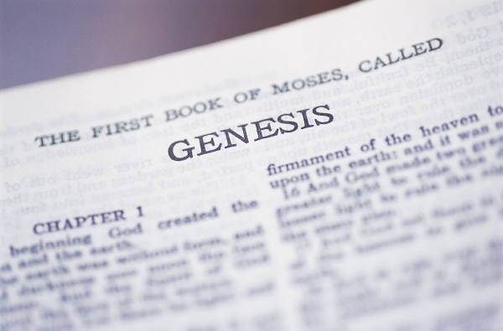
THE DAYS OF GENESIS
Part 3
In Defense Of Genesis
All verses are from the NKJV unless noted

Slide 2
Examples of Brethren Attacking Genesis
GENESIS

Slide 3
Shane Scott, former Bible Professor at Florida College

Slide 4
Shane Scott; Sentry Magazine; Vol. 21, No. 1
“Some Bible believers insist that the world must be only 6,000 years old, because the world was created in six days, according to Genesis 1…”

Slide 5
Shane Scott; Sentry Magazine; Vol. 21, No. 1
THE DAYS CANNOT BE LITERAL The “days” of creation in Genesis 1 cannot be literal because of the parallel account of creation in Genesis 2. After God put man in the Garden, He paraded the animals before Adam, who “gave names to all the cattle…birds…and to every beast of the field” (2:20)…Some amount of time must have passed between Adam’s creation, the naming of the animals and then Eve’s creation. …Because of all the things that occurred on the sixth day as described in Genesis 2, the sixth day of Genesis 1 cannot be literal.”

Slide 6
REALLY?
Notes:
Without a woman, would it take man a million years to name the animals?
Would you want this fellow teaching your children about the Bible?

Slide 7
What kind of hermeneutical approach does this instill into the youth?
ANSWER:
Bible authority is reduced to subjectivism
The Bible begins saying what it doesn’t mean
The straightforward reading of the scriptures is a flawed approach
Yet they become angry when we treat their writings the way they do the scriptures!
You cannot trust the way the Bible reads
Man’s thinking is superior to the words of the Holy Spirit
Notes:
This issue is so much deeper than “days” or “ages.” It is actually leveled at the way we approach scripture.
If we make their writings mean something other than what it says, they become livid. But they are well pleased to make God’s writings mean something completely different than what it says? It is a form of amazing arrogance!

Slide 8
Notable Observation
“We have always maintained that conclusions to Bible inferences must be forced, necessary, and unavoidable for them to be valid. Once the line of thinking is adopted that not just necessary inferences are binding but also possible inferences, the window is open for every wind of doctrine. You will not be able to draw doctrinal lines on salvation, elder qualifications, MDR, ad infinitum, because ‘might maybes’ have become ‘must therefores.’ The hermeneutic crumbles, and this is exactly what some want, so they cannot be told they are wrong.”

Slide 9
Notable Observation
“…Shane’s logic is deplorable and is consistent with every other false teacher wresting the scriptures. That he at least has not adopted natural evolution is not commendable, in my opinion. Even the Baptists, Catholics, Methodists, JW’s, and yea also perhaps evolutionists hold to a little bit of truth, too. It’s the 1% poison in rat bait that kills; the 99% wholesome wheat is of no benefit to the rat if it is dead. Mix the right amount of error with truth and you’re feeding the church a deadly potion” (emp. mine, sjw)

Slide 10
Creation Museum (2800 Bullittsburg Church Rd., Petersburg, KY 41080)

Slide 11
DOES IT MATTER HOW WE APPROACH GENESIS?
Tom Couchman says “NO!”
“Unless I misunderstand, the sixty-seven ‘most assuredly’ view disagreement on the interpretation of Genesis as ‘a reason for breaking fellowship between brethren.’ …I cannot see why anyone who values unity would participate in a discussion initiated for the express purpose of dividing brethren over an issue which has nothing to do with obedience to the gospel message, imitation of Christ or the ministry of the New Testament church.”

Slide 12
If you do not believe…
“I cannot see why anyone who values unity would participate in a discussion initiated for the express purpose of dividing brethren over an issue which has nothing to do with obedience to the gospel message, imitation of Christ or the ministry of the New Testament church” (Tom Couchman)
“For if you believed Moses, you would believe Me; for he wrote about Me. But if you do not believe his writings, how will you believe My words?” (Jesus Christ, Jn. 5:46, 47)

Slide 13
If you do not believe…
“I cannot see why anyone who values unity would participate in a discussion initiated for the express purpose of dividing brethren over an issue which has nothing to do with obedience to the gospel message, imitation of Christ or the ministry of the New Testament church” (Tom Couchman)
Why do we obey the gospel?
To be saved from sin (Acts 2:38)
Why must we be saved from sin?
Because the wages of sin is death (Rom. 6:23)
How do we know?
Genesis 2:16-17

Slide 14
If you do not believe…
“I cannot see why anyone who values unity would participate in a discussion initiated for the express purpose of dividing brethren over an issue which has nothing to do with obedience to the gospel message, imitation of Christ or the ministry of the New Testament church” (Tom Couchman)
“For since by man came death, by Man also came the resurrection of the dead. For as in Adam all die, even so in Christ all shall be made alive” (1 Cor. 15:21, 22)
The gospel is tied to Adam and the Genesis record

Slide 15
Genesis 1 Serves As A Test Regarding Our Approach To God’s Word
Luke 10:26,
“He said unto him, What is written in the law? how readest thou?” (KJV)

Slide 18
Proverbs 30:5, 6

Slide 19
Proverbs 30:5, 6

Slide 20
Proverbs 30:5, 6

Slide 21
REASONS WHY THE DAYS OF GENESIS ONE MUST BE CONSECUTIVE CALENDAR DAYS

Slide 22
“By Man Came Death” (1 Cor. 15:21)
Cannot be reconciled with long ages!
Millions of Years
Day 1 | Day 2 | Day 3 | Day 4 | Day 5 | Day 6 | Day 7
Light | Division of waters | Dry land, grass, herb, fruit | Sun, moon, stars | Sea and air creatures | Land creatures, man, woman | Rest
DEATH
1.
If each day represents millions of years, then sea creatures, birds and even land animals would have been existing and dying for millions of years before Adam!

Slide 23
“…So the evening and the morning were the first day” (Gen. 1:5)
Cannot be reconciled with long ages!
Millions of Years
Day 1 | Day 2 | Day 3 | Day 4 | Day 5 | Day 6 | Day 7
Light | Division of waters | Dry land, grass, herb, fruit | Sun, moon, stars | Sea and air creatures | Land creatures, man, woman | Rest
Evening/ Morning
Evening/ Morning
Evening/ Morning
Evening/ Morning
Evening/ Morning
Evening/ Morning
Evening/ Morning
2.
If each day represents millions of years, then we must understand there were millions of years of darkness along with millions of years of light in each day-age!

Slide 24
“Let there be lights in the firmament…let them be for signs and seasons, and for days and years” (Gen. 1:14)
Cannot be reconciled with long ages!
Millions of Years
Day 1 | Day 2 | Day 3 | Day 4 | Day 5 | Day 6 | Day 7
Light | Division of waters | Dry land, grass, herb, fruit | Sun, moon, stars | Sea and air creatures | Land creatures, man, woman | Rest
3.
If days mean ages, what are “years” and “seasons” supposed to mean?

Slide 25
WHAT IS THE BASIS
FOR THE SEVEN DAY WEEK?
Cannot be reconciled with long ages!
Millions of Years
Day 1 | Day 2 | Day 3 | Day 4 | Day 5 | Day 6 | Day 7
Light | Division of waters | Dry land, grass, herb, fruit | Sun, moon, stars | Sea and air creatures | Land creatures, man, woman | Rest

Slide 26
WHAT IS THE BASIS
FOR THE SEVEN DAY WEEK?
Cannot be reconciled with long ages!
Millions of Years
Day 1 | Day 2 | Day 3 | Day 4 | Day 5 | Day 6 | Day 7
Light | Division of waters | Dry land, grass, herb, fruit | Sun, moon, stars | Sea and air creatures | Land creatures, man, woman | Rest

Slide 27
WHAT IS THE BASIS
FOR THE SEVEN DAY WEEK?
Cannot be reconciled with long ages!
Millions of Years
Day 1 | Day 2 | Day 3 | Day 4 | Day 5 | Day 6 | Day 7
Light | Division of waters | Dry land, grass, herb, fruit | Sun, moon, stars | Sea and air creatures | Land creatures, man, woman | Rest

Slide 28
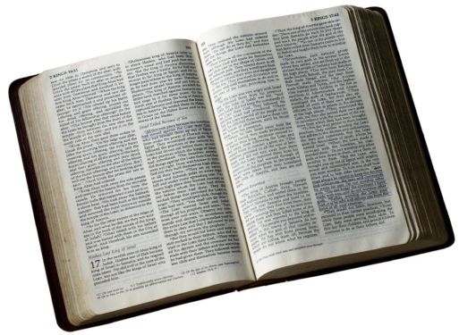
WHAT IS THE BASIS
FOR THE SEVEN DAY WEEK?
Cannot be reconciled with long ages!
Millions of Years
Day 1 | Day 2 | Day 3 | Day 4 | Day 5 | Day 6 | Day 7
Light | Division of waters | Dry land, grass, herb, fruit | Sun, moon, stars | Sea and air creatures | Land creatures, man, woman | Rest
‘It is a sign between Me and the children of Israel forever; for in six days the LORD made the heavens and the earth, and on the seventh day He rested and was refreshed.’"
4.
Exodus 31:17

Slide 29
“But from the beginning of the creation, God ‘made them male and female.’” (Mark 10:6)
Cannot be reconciled with long ages!
Millions of Years
Day 1 | Day 2 | Day 3 | Day 4 | Day 5 | Day 6 | Day 7
Light | Division of waters | Dry land, grass, herb, fruit | Sun, moon, stars | Sea and air creatures | Land creatures, man, woman | Rest
Adam Eve
MILLIONS OF YEARS
5.
If each day were an age, man and woman would be placed at the end of creation, not the beginning!
Notes:
Embracing long ages rejects Jesus. Embracing long ages makes Jesus an abject liar. Either God is true and man is a liar or man is true and God is a liar (Rom. 3:4)!

Slide 30
5 Simple Reasons Why
Long ages place the reality of death prior to sin
Long ages would require there to be millions of years of darkness followed by millions of years of light
Long ages render “years” and “seasons” as incomprehensible
Long ages destroy the only reason for having a seven day work week
Long ages place Adam and Eve at the end of creation rather than at the beginning

Slide 31
How Do You Approach The Scripture?
Thousands Of Yrs., Lit. Creation, Days,
Flood, Etc.
NOTHING
Millions Of Yrs., Theistic Evol., Day-age, Gap, Local Flood
MAN’S IDEAS

Slide 32
Authority Breakdown!
If the “DAYS” can be INTERPRETED AS “AGES,” then:
Why not interpret, “by the resurrection from the dead” to “by the resuscitation from the dead” (Rom. 1:4)
If long age geology, why not long age biology?
Why not also reinterpret “whoever” as “when a believer” (Matt. 19:9)?
Why not also reinterpret “week” as “year” (Acts 20:7)
Is Genesis 1 important for us to know what day the early church broke bread?
Does this have anything to do with obeying the gospel (Acts 2;42)?
Notes:
We must know what the first of the seven is in order to obey and imitate this example.

Slide 33
Caution To Word Changers
“Woe to those who call evil good, and good evil; Who put darkness for light, and light for darkness; Who put bitter for sweet, and sweet for bitter!” (Is. 5:20)

Slide 34
THE PLAN FOR
YOUR SALVATION
Hear the Word of God---Rom. 10:17
Believing In Your Heart---Heb. 11:6
Repenting Of Your Sins---Acts 2:38
Confess That Christ Is The Son of God--- Rom. 10:10; Acts 8:37
Be Baptized Into Christ---Gal. 3:26-29
Be Faithful Until Death---Rev. 2:10; I Cor. 15:58

